Slide 1
Overview of AI

Slide 2
Surprise! Surprise!

Slide 3
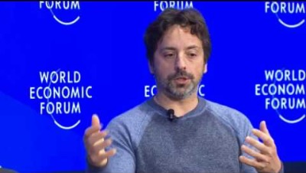

Slide 4
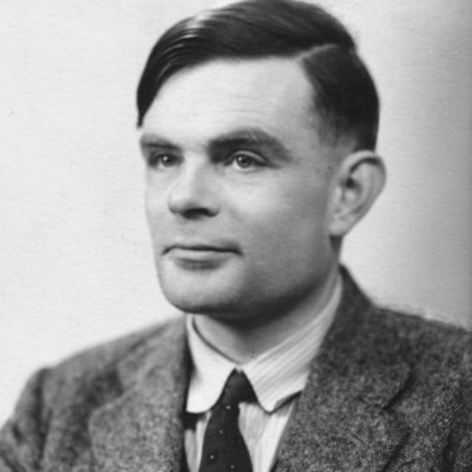
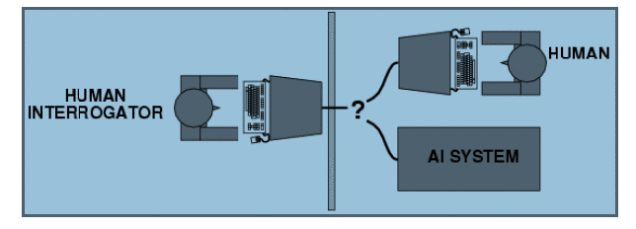
What is AI?
Machines that can think
How to test the level of intelligence?
Turing Test (1950)

Slide 5
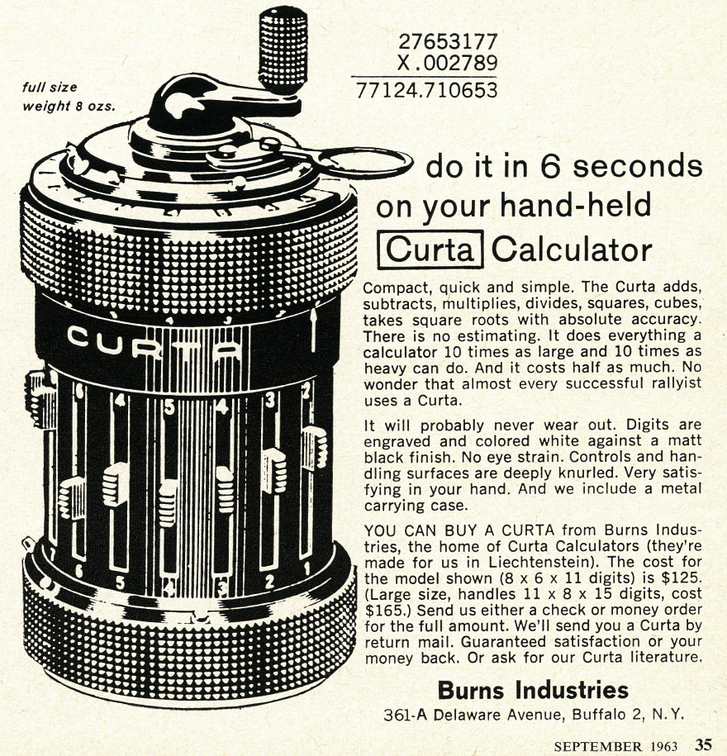
How to make machines intelligent?
AI
Mechanical

Slide 6
How to make machines intelligent?
AI
Mechanical
Knowledge base: Logic and ontology, with formal rules
Think of this approach as the “pure and clean” way.
Like playing chess.
Problems:
the rules exploded!
For every rule, there is an exception!
Conflicting and hard to maintain.

Slide 7
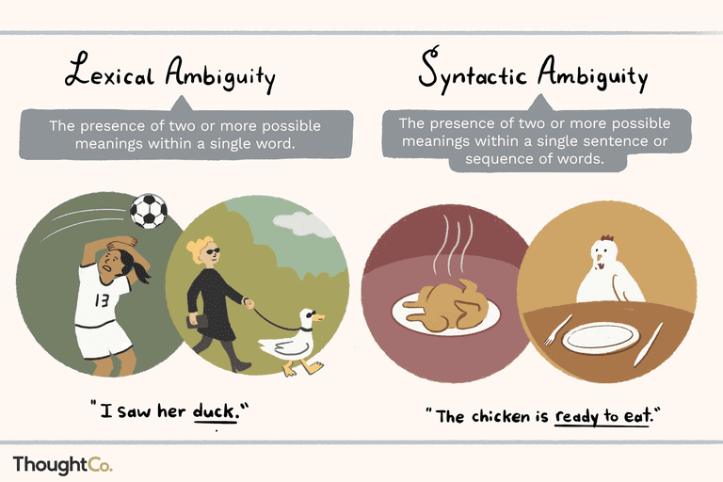



Ambiguity
Blog: Definition and Examples of Ambiguity

Slide 8


Detecting Fraudulent Doctor Review
“Dr Kant and his team is very skillful and hard working, very well recommended to everyone, best dental experience I had at this clinic.”
“Dr. explained everything in detail, medication given was really good, we are very happy to consult this doctor, we highly recommend this doctor.”
Source: Shukla, Wang, Gao and Agarwal 2018

Slide 9
How to make machines intelligent?
AI
Mechanical
Knowledge base: Logic and ontology, with formal rules
Statistical learning/Machine learning
Logistic regression
Ex: Predict(Readmission) = f(patient age, gender, diagnosis, medication)
Features

Slide 10
How to make machines intelligent?
AI
Mechanical
Knowledge base: Logic and ontology, with formal rules
Statistical learning/Machine learning
Logistic regression
Ex: Predict(Readmission) = f(patient age, gender, diagnosis, medication)
But some features are hard to quantify:
-such as images of the bone fracture
Representation learning
Features

Slide 11
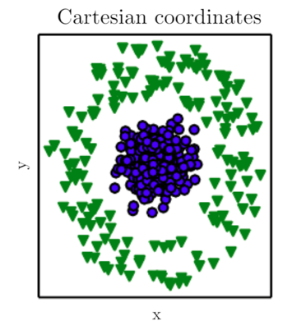
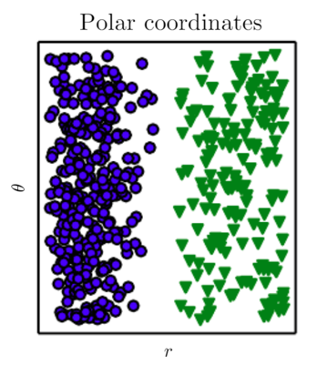
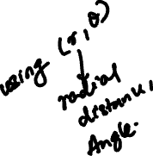
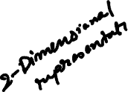



Why is Representation important?
Compare:
XCIX –XVI =?
99 – 16 = ?
01100011 - 00010000
How to separate the dots by a single straight line?

Slide 12
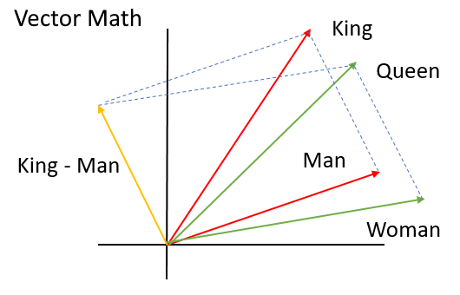
Why is Representation important?
How to compute natural language: Word2Vec
King – Man = Queen – Woman

Slide 13
How to make machines intelligent?
AI
Statistical learning/Machine learning
Representation learning
Deep Neural Network (DNN)
CNN, RNN, GANS

Slide 14
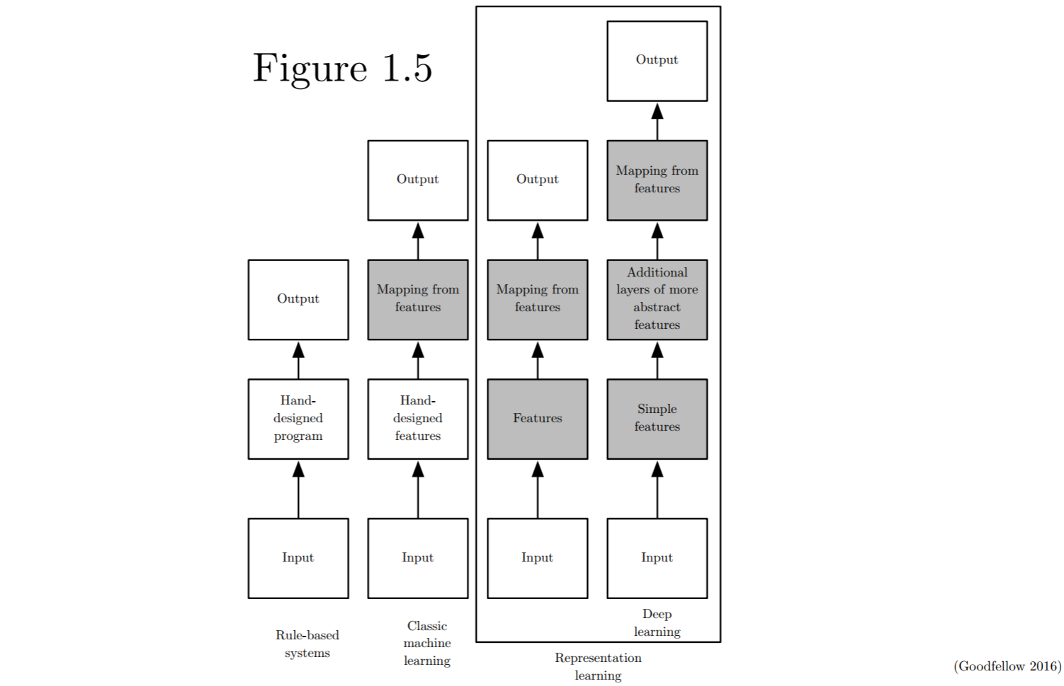
Shaded boxes indicate learning from data (rather than hand-designed)

Slide 15
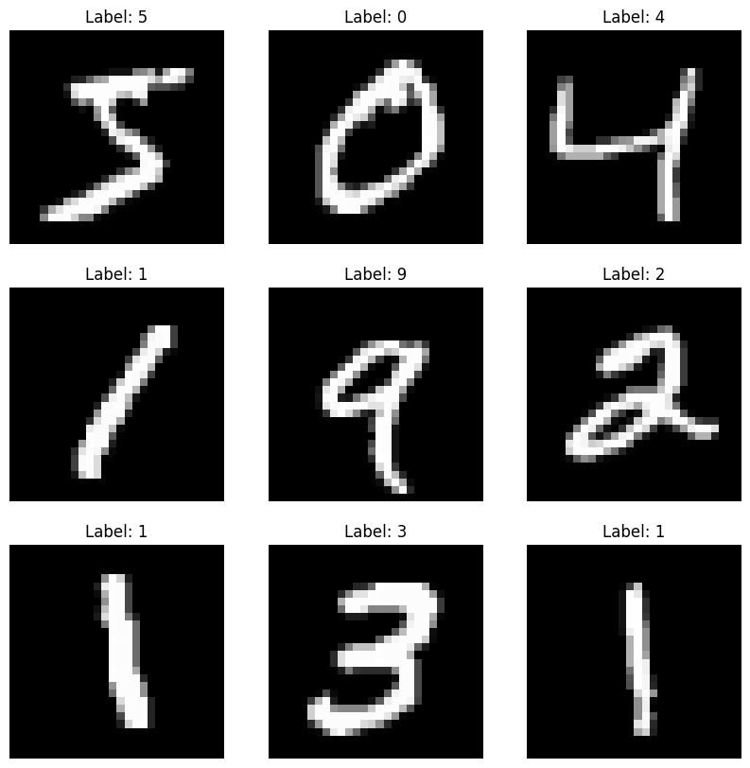
Features…

Slide 16
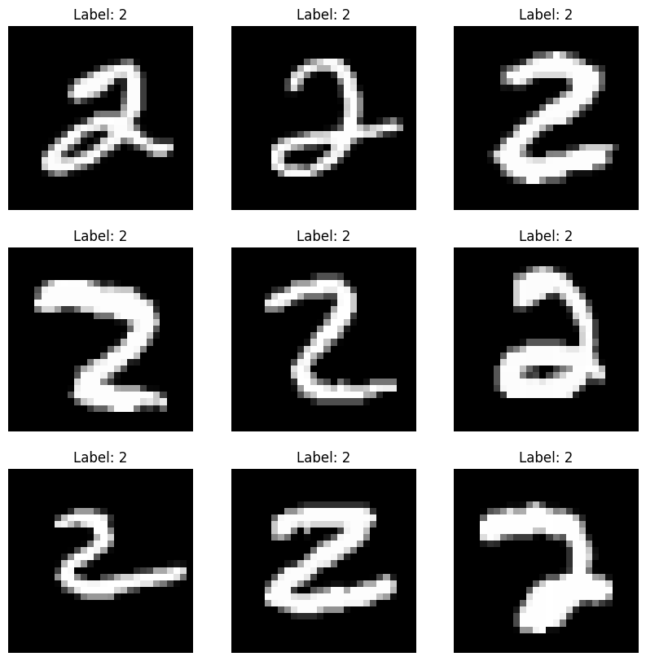

Slide 17

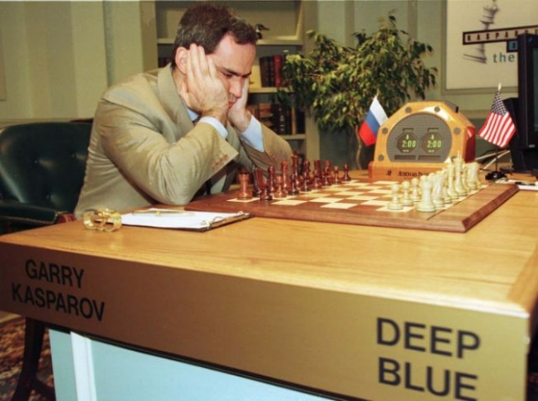
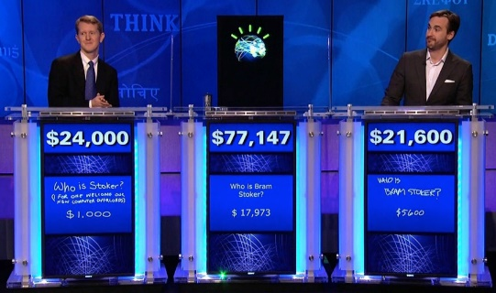
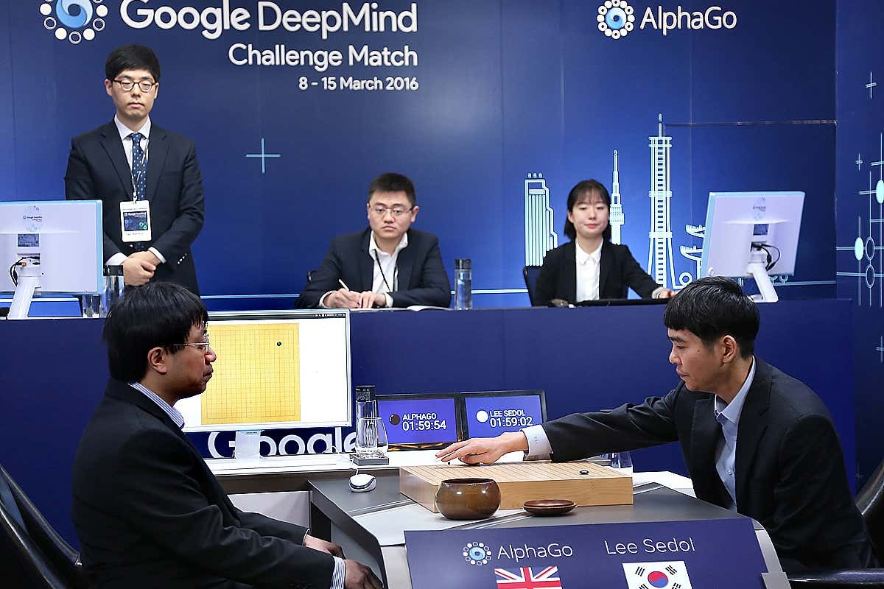
Milestones in AI
1997
Rule-based system/Symbolic
2011
Machine Learning/ Statistical Learning
2016
Deep Learning/
Neural Network
1997
2011
2016
IBM Deep Blue
IBM Watson
Google AlphaGo

